Slide 1
Canny Edge Detector
Sara Fattouh

Slide 2
Edge
•Drastic change of intensity across object contour.
•A location with high gradient (derivative).

Slide 3
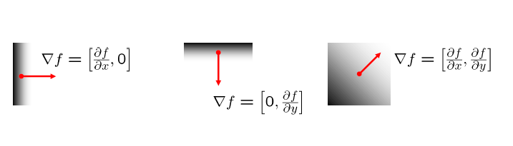
Detecting Edges in Image
The Gradient
An image gradient is a directional change in the intensity or
color in an image.
Image gradients may be used to extract information from images.

Slide 4
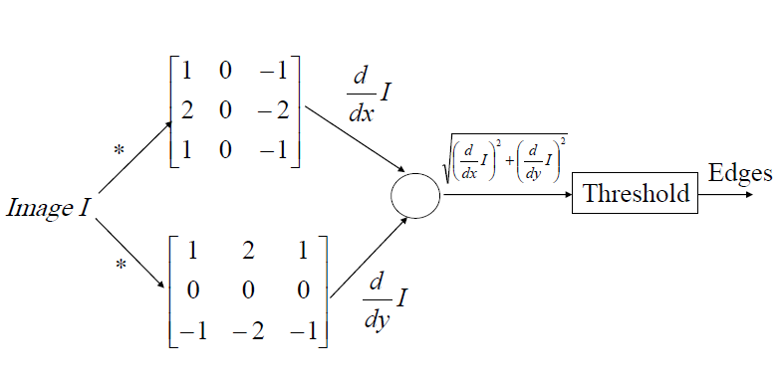
Detecting Edges in Image
Sobel Edge Detector

Slide 5
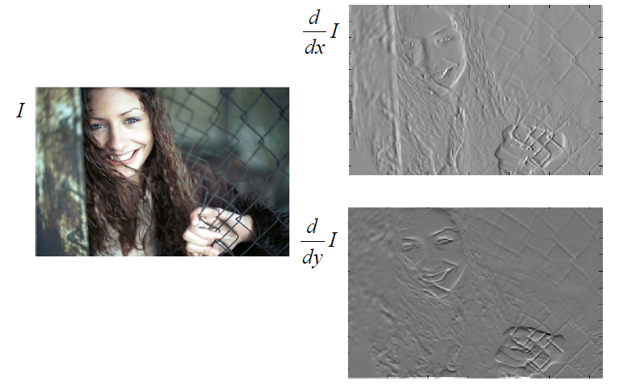
Sobel Edge Detector

Slide 6
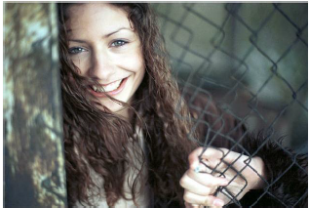
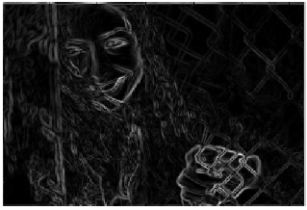
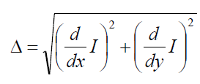
Sobel Edge Detector

Slide 7
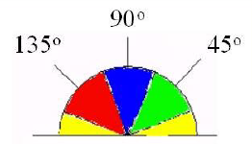
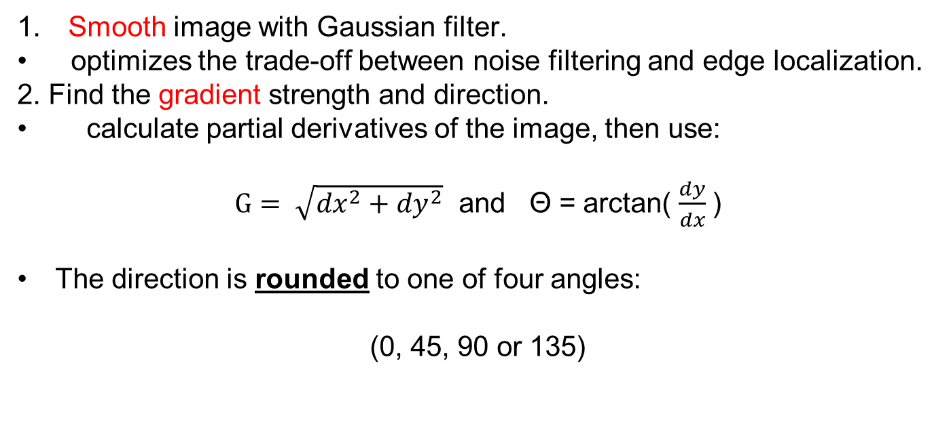
Canny Edge Detector
Smooth image with Gaussian filter.
optimizes the trade-off between noise filtering and edge localization.
2. Find the gradient strength and direction.
calculate partial derivatives of the image, then use:
$G= \sqrt{{dx}^{2}+{dy}^{2}}$ and Θ = arctan( $\frac{dy}{dx}$)
The direction is rounded to one of four angles:
(0, 45, 90 or 135)

Slide 8
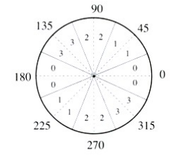
Canny Edge Detector
3. Thin edges by applying non-maxima suppression to the gradient magnitude.
4. Detect edges by double thresholding.

Slide 9
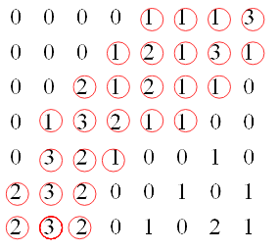
Non-Maxima Suppression
Thin edges by keeping large values of the gradient.
there are many thick edges.
thin the broad edges into edges with one-pixel wide

Slide 10
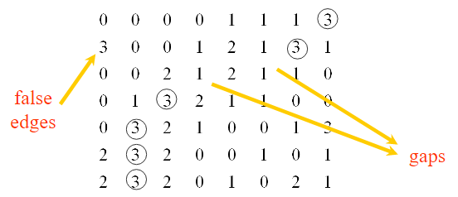
Non-Maxima Suppression

Slide 11
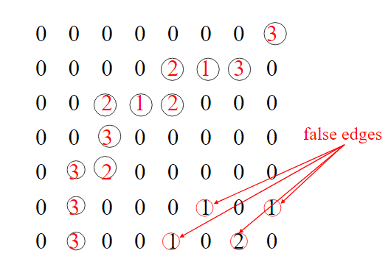
Non-Maxima Suppression
The suppressed magnitude image will contain many false edges.
Reduce number of false edges, by applying a threshold T.
Some false edges will remain if T is too low.
Some edges will disappear if T is too hight.

Slide 12
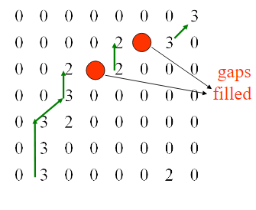
Hysteresis
Canny uses 2 thresholds, Low (L) and Hight(H).
1. If M[i,j] > H , then M[i,j] is accepted as an edge.
2. If M[i,j] < L , then M[i,j] is rejected.
3. If L< M[i,j] <H , then it will be accepted only if it is connected to a pixel that is above the upper threshold.
By doing so, we are linking the pixels in the gap
with the neighbor ones having greater values.

Slide 13
Thanks!
Let’s go to the code!

